Slide 1
GUI App for Garbage collection
system
By:
Vishal Naik

Slide 2
Introduction:
GUI was developed using Tkinter
Basic functions include:
1. Getting Data from Ultrasonic sensor(Hardware)
2. Display the result to the user
3.Get some inputs from the user
4. Send the data to Cloud

Slide 3
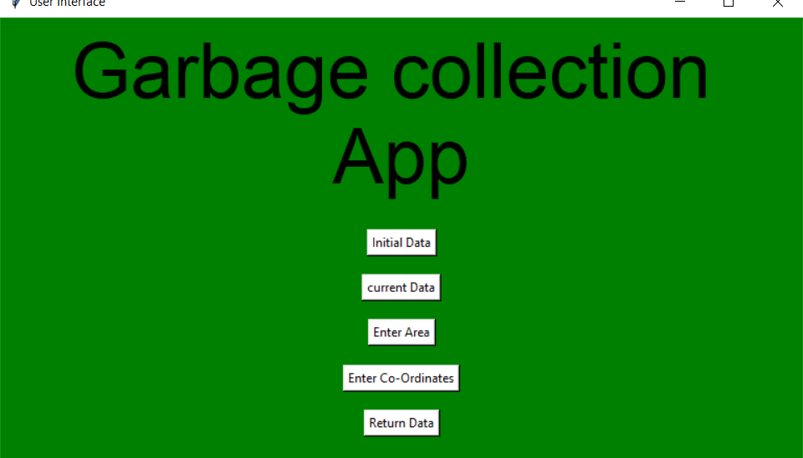

Slide 4
Working of Buttons:
1.Initial Data: It takes the initial depth of the dustbin (Previous) and percentage
filled from the sensor/hardware
2.Current Data: It takes the current depth of the dustbin (Previous) and
Percentage filled from the sensor/hardware and updates the values
3.Enter Area: user enters the area from which the data being collected
4.Enter co-ordinate: user enters the x , y co-ordinate (Longitude and Latitude)
5.Return Data:Return the user entered data and current data to the cloud

Slide 5
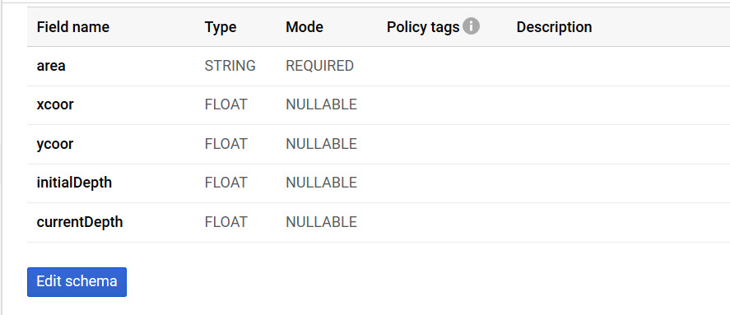

Slide 6
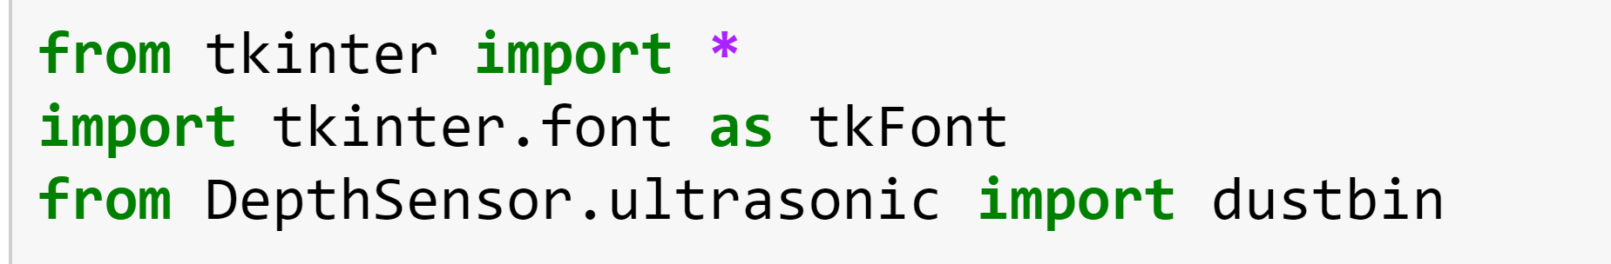
Source code:

Slide 7
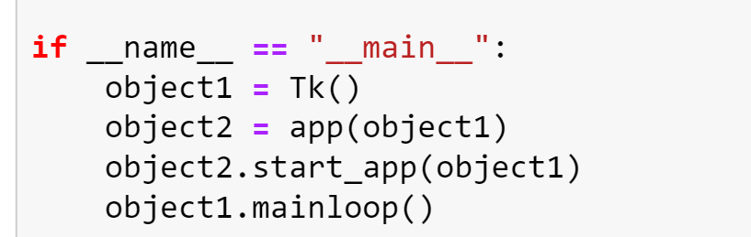

Slide 8
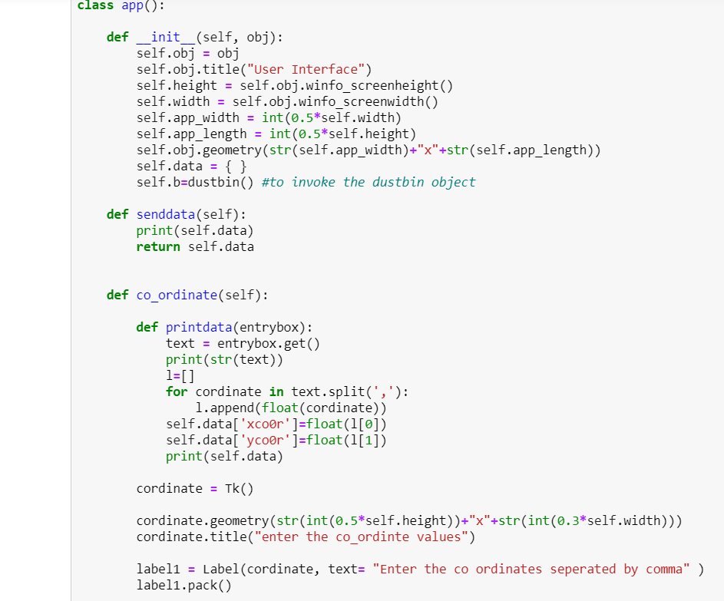

Slide 9
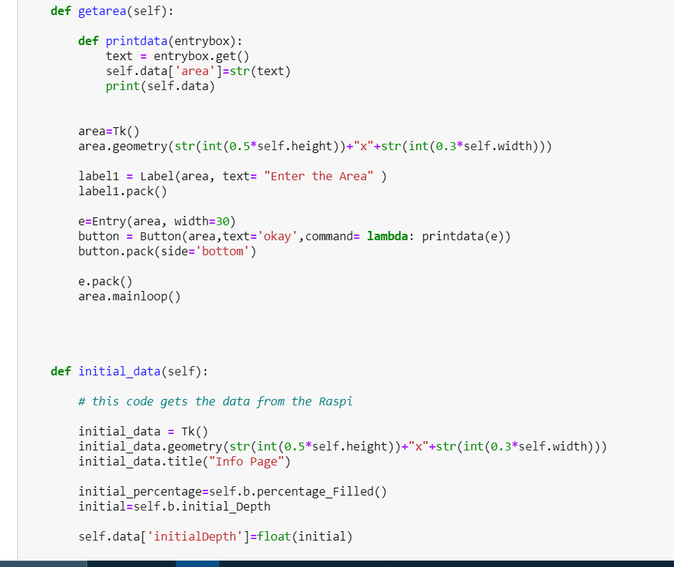

Slide 10
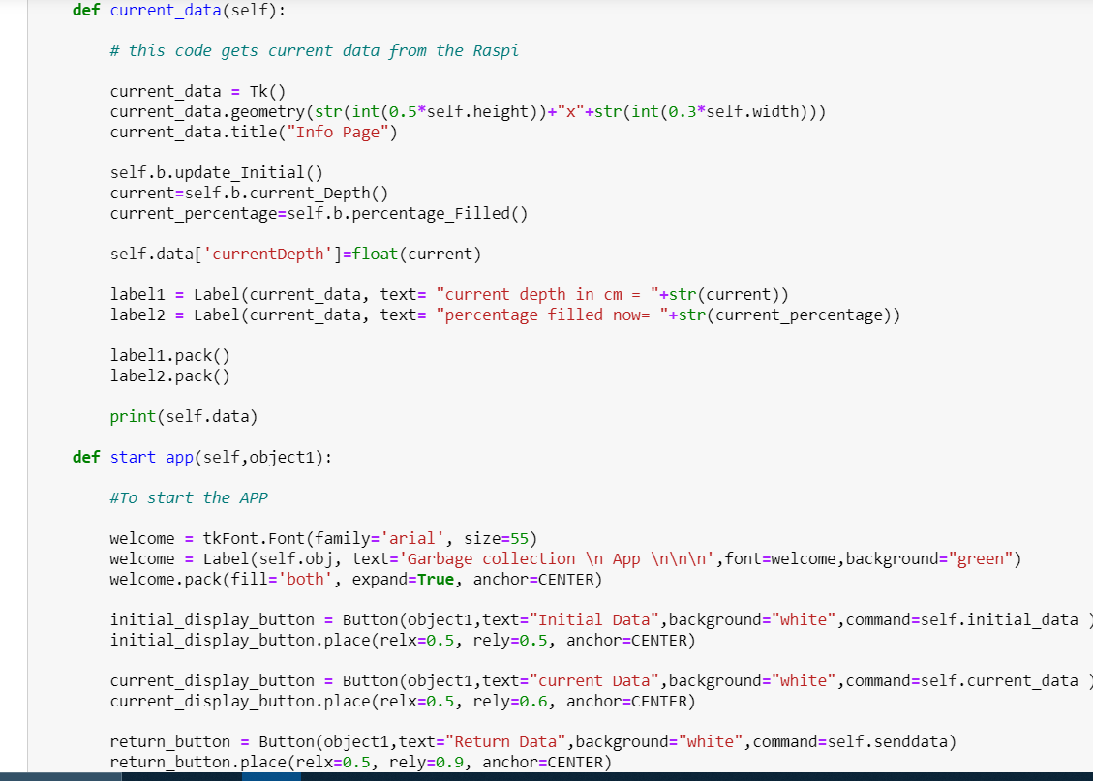

Slide 11
Thank You

